Slide 1
Forge your AR/VR Content
Cyrille Fauvel
Developer Advocate

Slide 2
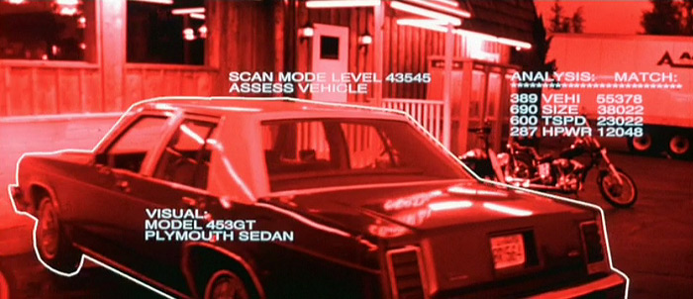
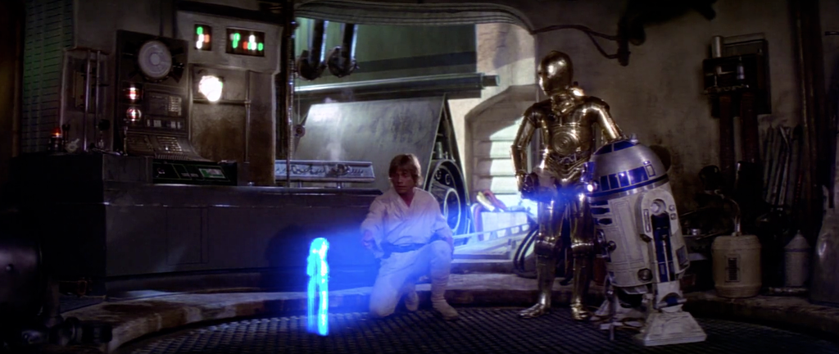
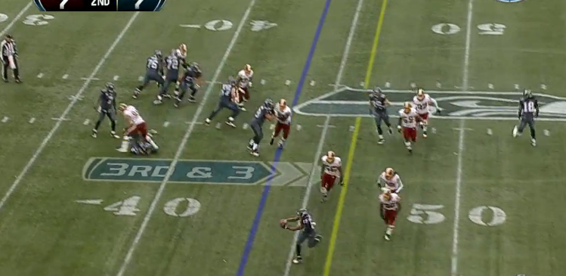
Notes:
History/vision - Star Wars/Terminator/NFL

Slide 3
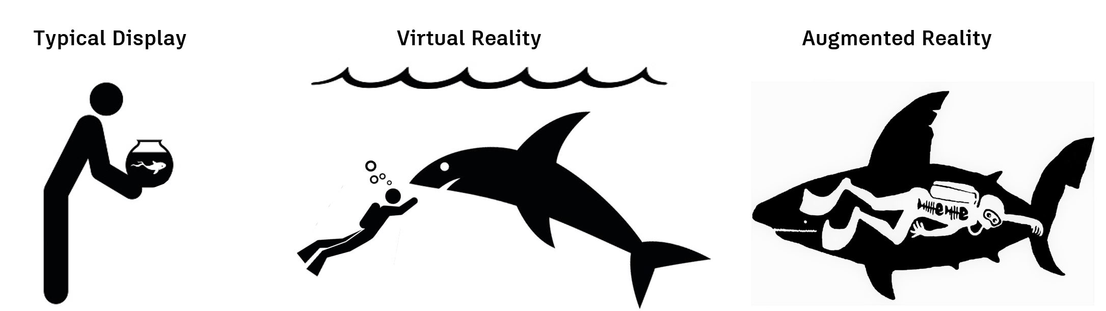
Notes:
Differentiate from VR, bigger market than VR

Slide 4

500 Million Downloads

Slide 5
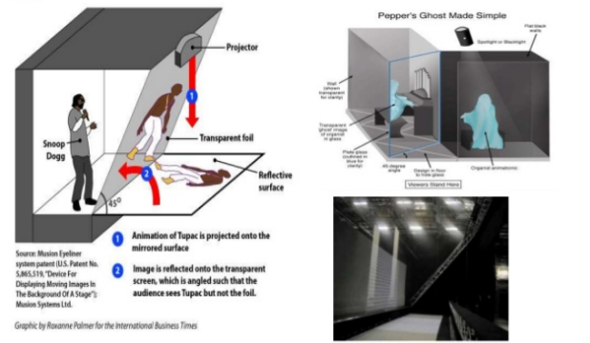
Traditional working setup

Slide 6

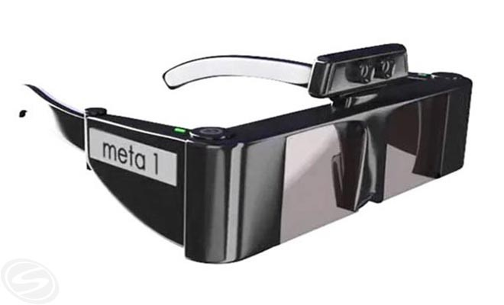
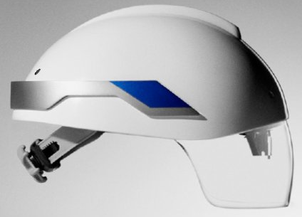
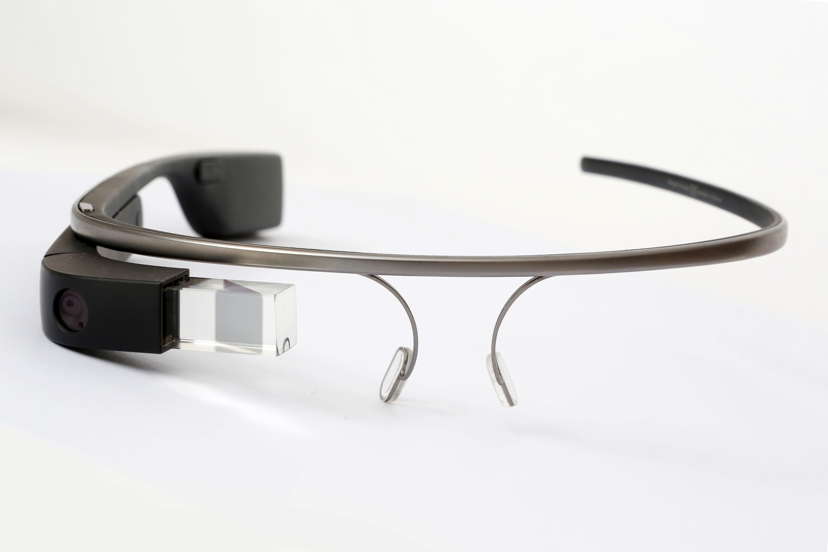

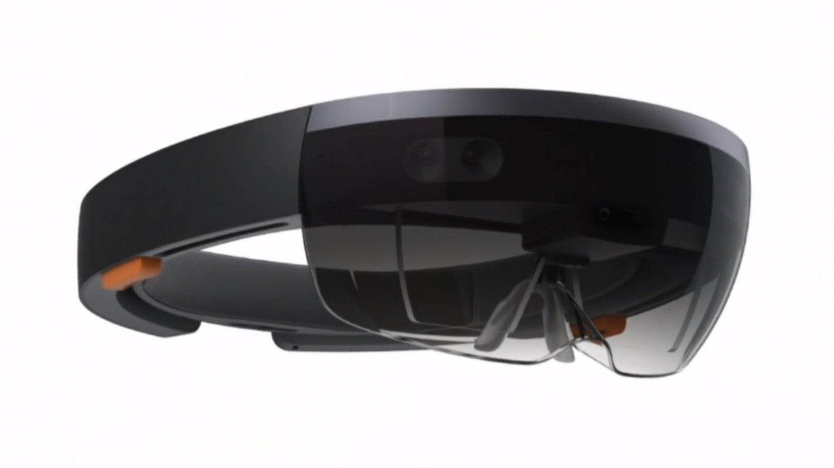




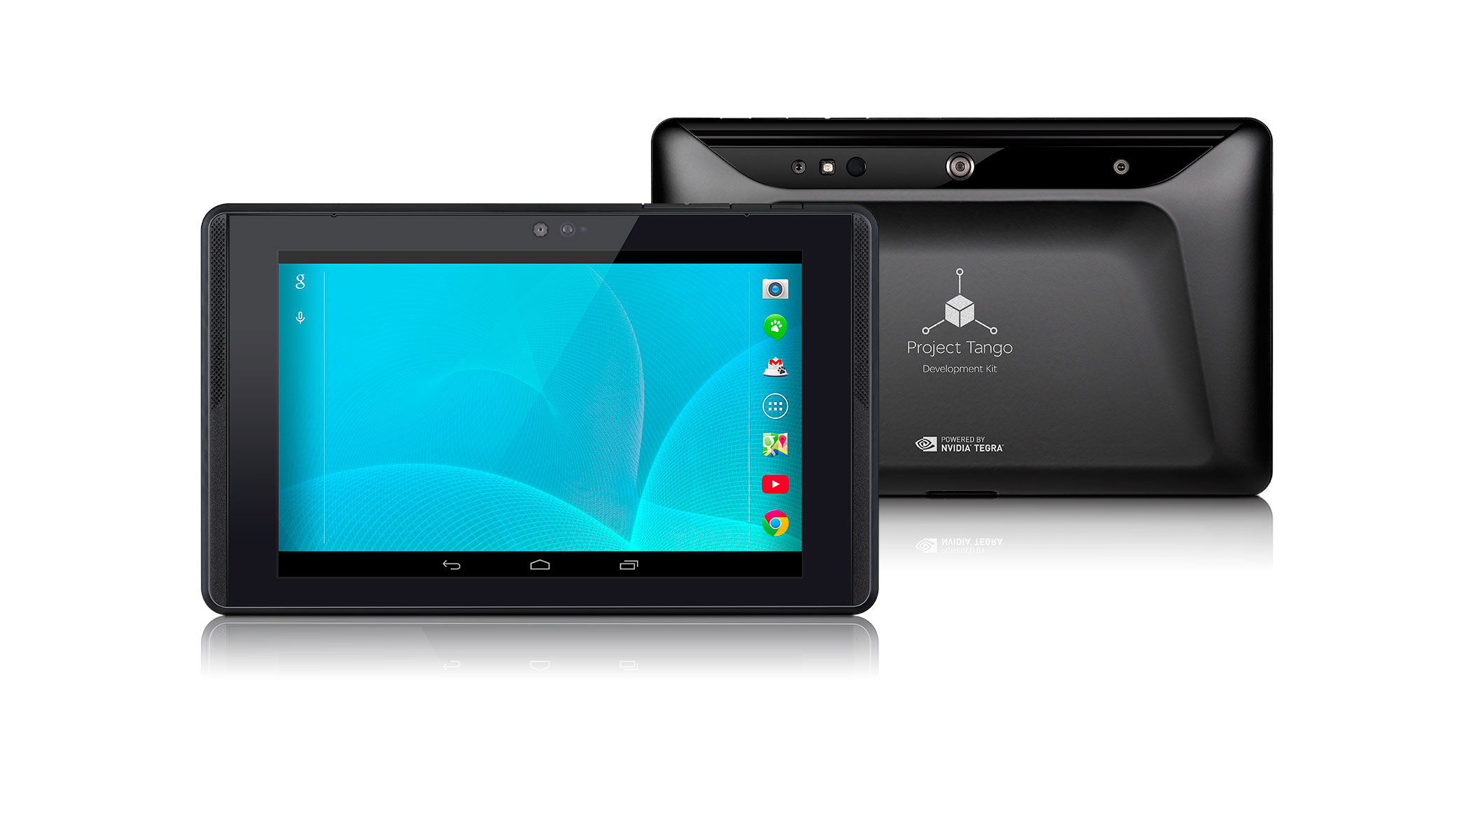

1990s
2000s
TODAY
Notes:
From custom to commercialized; Google glass/HUD, MS Holo, Tango, Apple, DAQRI – still early, but big HW allows us to focus on and test our SW ideas.

Slide 7
In practical terms, VR will succeed or fail based on
content and how easy it is to access that content.
There is no easier or more ubiquitous content
delivery mechanism than the WEB.
Vladimir Vukicevic
Mozilla
Notes:
http://www.slideshare.net/fitc_slideshare/web-vr-fitc

Slide 8

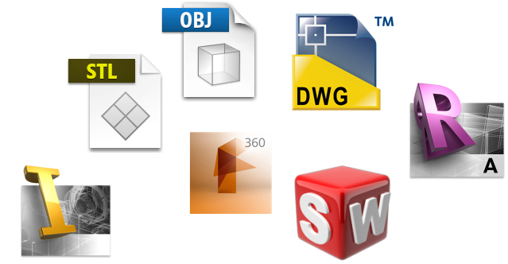

Design data
© 2016 Autodesk

Slide 9
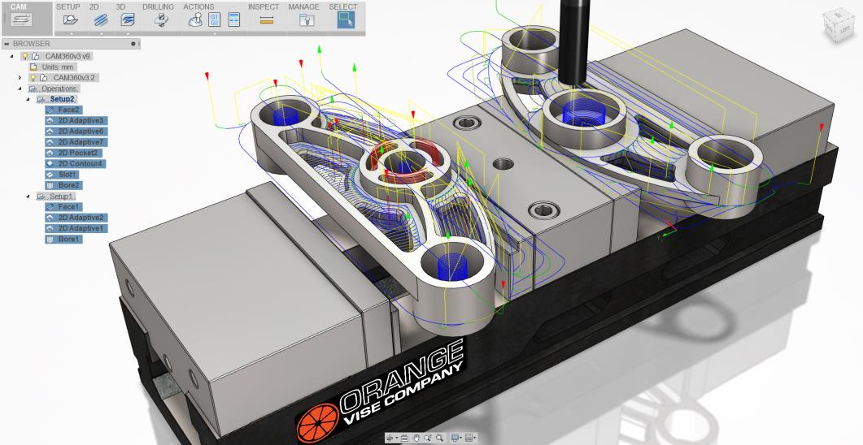
Autodesk Fusion 360

Slide 10
Forge API launched in June
Launched
Authentication
Data Management API
Model Derivative API -> More format coming
Viewer
Design Automation API
Review Queue
3D Print API
BIM 360 API
Issues API
Reality Capture API
Fusion Connect API
Data Management enhancements
Notes:
View and Data API was split into multiple WEB services
Autodesk.IO is now Automation Design API
…

Slide 11
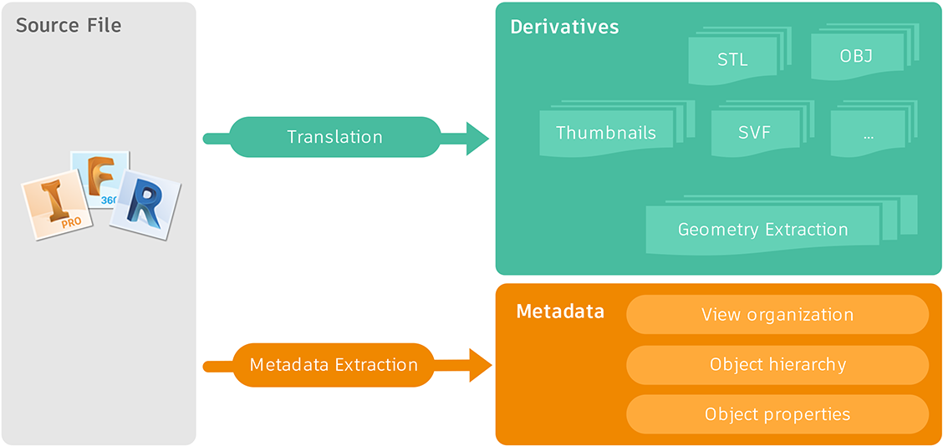
Model Derivative API POST a translation job
Register the file through translation
POST /modelderivative/v2/
designdata/job
© 2016 Autodesk
Notes:
{
"input": { "urn":"dXJu...56aXA“ },
"output": {
"destination": { "region": "us” },
"formats": [{
"type": "svf",
"views":["2d","3d"]
}]
}
}

Slide 12
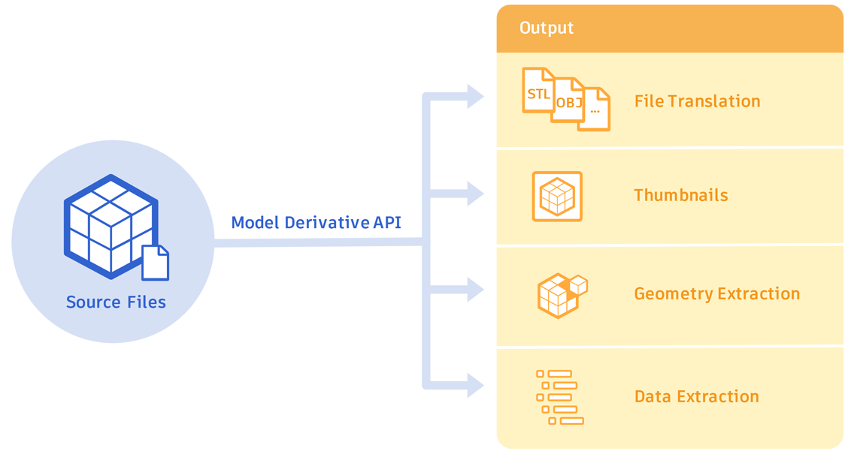
Derivative: extract generic data
Object hierarchy tree
Thumbnail
Properties
Geometry
Notes:
What was again all the info that the viewer pulled from this service?
The hierarchy of the model, all the geometric and meta data of the model. And it can also translate the model into various export formats: STL, STEP, IGES, OBJ, etc

Slide 13

Translation to other formats
Viewing/Data extraction: 60+ file formats
Export to:
OBJ:
any supported format at component level
Only geometry for now – textures coming
STEP, IGES, STL:
only specific file types and only at file level
© 2016 Autodesk
Notes:
There are 60+ formats supported for viewing and data extraction, and many of them are also available for export.
OBJ export is possible even at component level so you can pick and choose the components to export, while STEP, IGES and STL can only be done for the whole file – and currently not available for many design file formats.

Slide 14
GET Manifest
GET /modelderivative/v2/
designdata/
{urn}/
manifest
urn of output formats (Derivative urns)
status for requested output types
© 2016 Autodesk

Slide 15
GET Metadata
GET /modelderivative/v2/designdata/
{urn}/
metadata
Metadata: organization of views within model
Revit: display different views
Fusion: root model
© 2016 Autodesk

Slide 16
GET Hierarchy
GET /modelderivative/v2/
designdata/
{urn}/
metadata/
{guid}
Get object tree for specified metadata guid
© 2016 Autodesk

Slide 17
GET properties
GET /modelderivative/v2/
designdata/{urn}/
metadata/{guid}/
properties
Get the properties of a file through REST API
In the past, you needed to instantiate a viewer instance or parse the svf file in order to have access to those information
© 2016 Autodesk

Slide 18
GET thumbnail
GET modelderivative/
v2/
designdata/{urn}/thumbnail?
width=$WIDTH$ & height=$HEIGHT$
What if you just want to get the thumbnail of a model?
© 2016 Autodesk

Slide 19
GET derivative
GET modelderivative/
v2/
designdata/{urn}/manifest/ {derivativeurn}
Download derivative
Possible types STL, STEP, IGES, OBJ, SVF, thumbnail
OBJ:
any supported format at component level
STEP, IGES, STL:
only specific file types and only at file level
© 2016 Autodesk

Slide 20
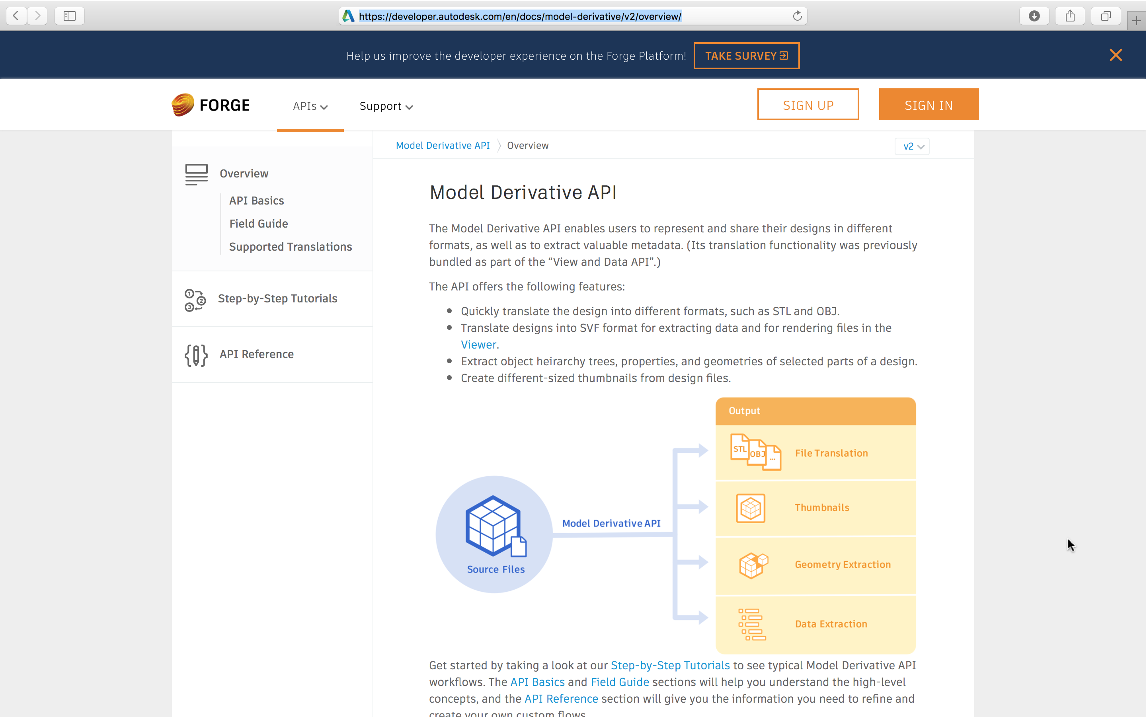
Notes:
Postman for Chrome or Mac
www.getpostman.com
Paw for Mac
luckymarmot.com/paw
Yaml
yaml.autodesk.io

Slide 21


Slide 22

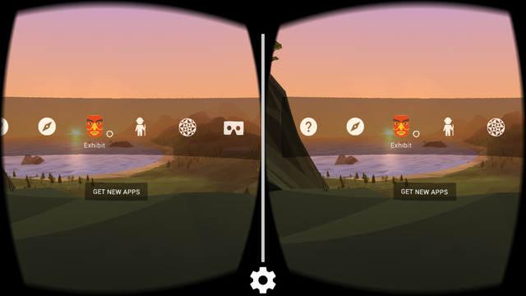
WEB-VR
Visual Immersion
Google cardboard
Occulus
GearVR
…
Per eye rendering
Per device distortion
Input options?
Notes:
http://vrok.it/
http://vr.autodesk.io/
http://aupano.autodesk.com/

Slide 23
AR for Architecture, Engineering, and Construction
Design Review
Design Mockups
Construction Layout
Construction Safety
Ownership Operations
Ownership Maintenance

Slide 24



THE CHALLENGE
IT’S HARD!
Image courtesy of XXXXXXXXX
Notes:
Design and CAD data is not realtime friendly
Why is it so hard to get data into game engines? Because it requires:
Skills
It takes time
It’s not reusable

Slide 25
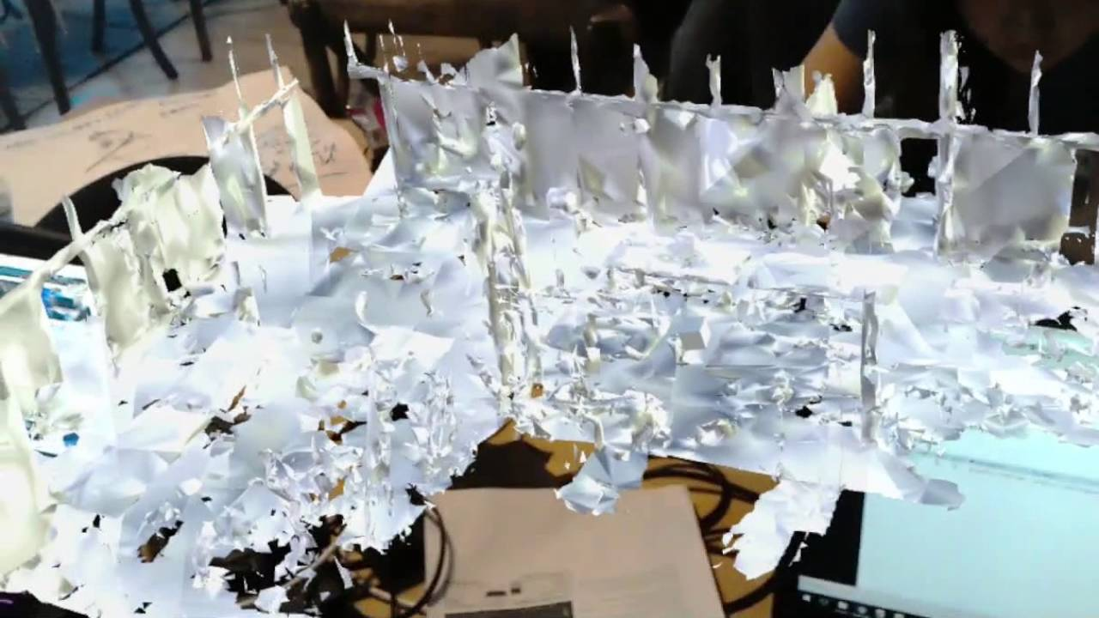
Real – capture of your environment

Slide 26
Get Started!
developer.autodesk.com
forge.autodesk.com
@AutodeskForge
facebook.com/adskForge
Notes:
Viewer
http://github.com/leefsmp/forge - https://forge.autodesk.io
Data Management API
https://github.com/Developer-Autodesk/data.management.api-nodejs-sample - http://forgedatamanagement.herokuapp.com/
Model Derivative API
https://github.com/Developer-Autodesk/model.derivative.api-nodejs-sample - https://modelderivative.herokuapp.com/

Slide 27

Q&A

